Slide 1
CS 3630 Project 2
Name: Jinchen Ma
GT email: jma337@gatech.edu
GT username: jma337
GTID: 903405388

Slide 2
1. What is the difference between CDF and PMF?
<PMF: probability mass function. CDF: cumulative distribution function.
PMF is a table that record the probability of each single corresponding action. It should sum to 1.
CDF is a table that records the cumulative probability of a list of orderred actions. It should not sum to 1. >

Slide 3
2. How did you implement maximum-probable explanation?
<I implemented the MPE with the Max-Product Algorithm for HMM we learned in class. To eliminate each (unobservable) variable, I first calculated the produce factor of that variable. Then create lookup tables -- one as the argmax of prior state, the other is the max value of prior state. after eliminated all but the last variables, I used back-substituation (using look up tables created before) to find the MPE>

Slide 4
3. What is the purpose of sampling and how is it used?
<Answer here.
Sample to pick an action/state at random according to PMF to represent action stochasticity>

Slide 5
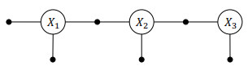
4. What is a factor graph?
<Factor graph is a Bipartite graph of variables and factors. It is the graph after converting all known variables in a Bayes net to “factors” that are known
example: below is a factor graph>

Slide 6
5. What did you learn in this project?
<I learned how to implement all the conceptual ideas we discussed during lecture to actual program that runs. Specifically, I learned to implement PMF, CDF, sampling, MPE with the Max-Product Algorithm for HMM, etc. I have also enhanced my understanding of these concepts by writing reflections. In addition to that, I also got the chance to practice coding and debugging in python>

Slide 7
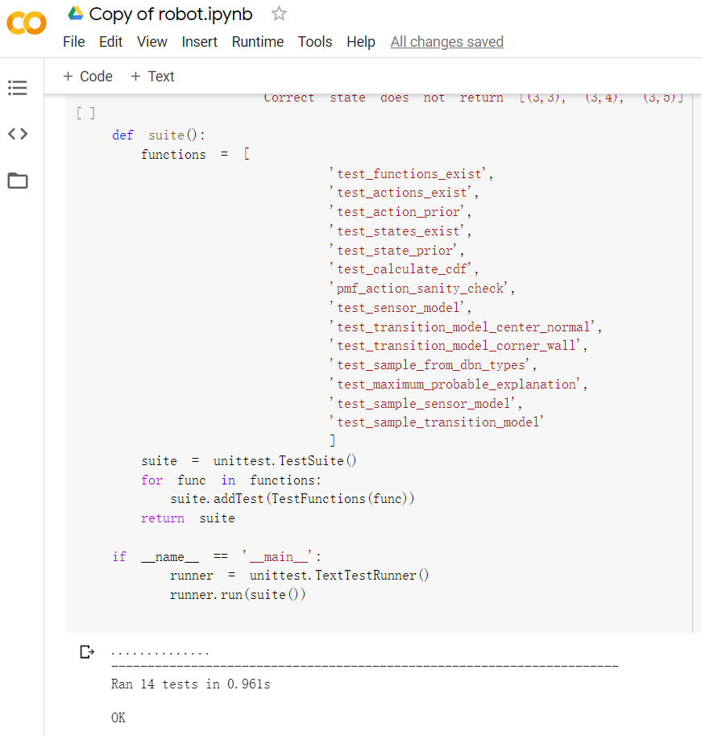
6. Screenshot and paste the output of running your unit tests here
..............
----------------------------------------------------------------------
Ran 14 tests in 0.961s
OK

Slide 8
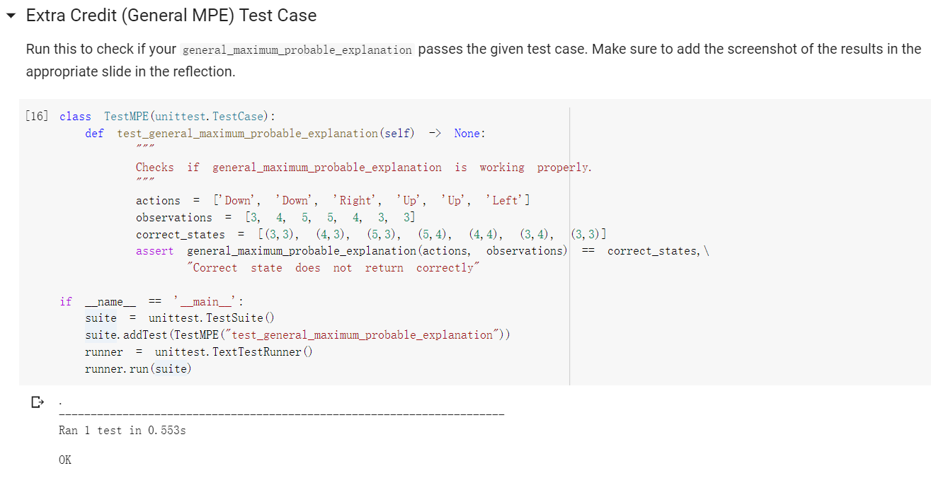
7. Extra-Credit - MPE: Screenshot and paste the output of running your extra-credit unit tests here
.
----------------------------------------------------------------------
Ran 1 test in 0.553s
OK

Slide 9
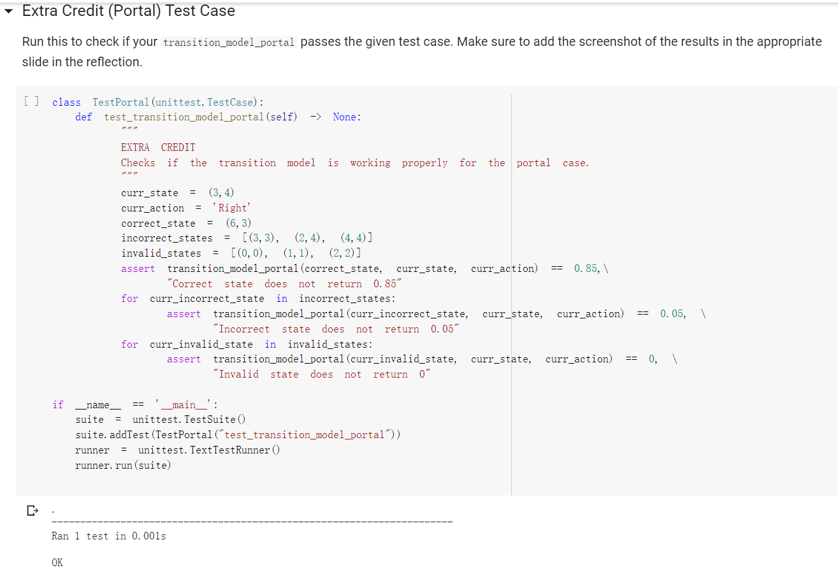
8. Extra-Credit - Portal: Screenshot and paste the output of running your extra-credit unit tests here
.
----------------------------------------------------------------------
Ran 1 test in 0.001s
OK

